Slide 1
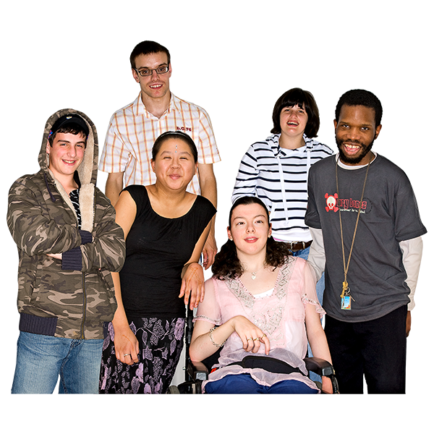
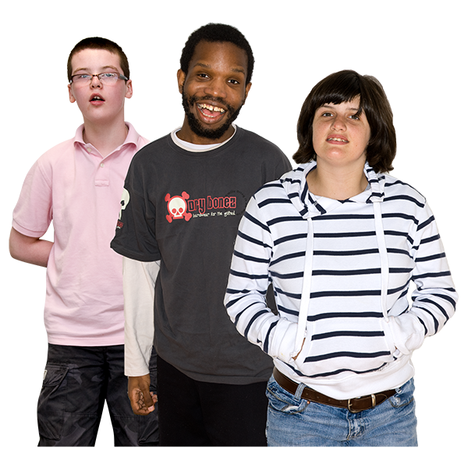
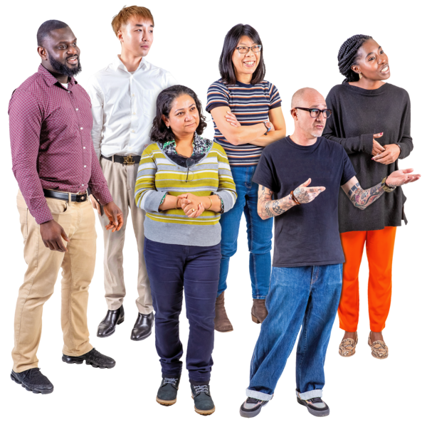
Child Friendly Safeguarding Statement Lucena Clinic CAMHS
Hospitality • Compassion • Respect
The safety and well being of you and all children is really important to all staff in Lucena Clinic CAMHS.
What does Safeguarding mean?
Safeguarding is what we do to keep you safe and protect you from harm/abuse.
All children need to be safe.
A child means under the age of 18. | Children need the right help at the right time when they do not feel safe. | Harm/abuse can happen anywhere. | We are all responsible for keeping you and others safe.
A staff member can help you if you do not feel safe.
It is OK to tell us.
Your safety is important. Your voice will be heard.
We are here to listen.
If you are worried about yourself or someone else you can tell us.
We will help.
We have policies and procedures to keep children safe.
Confidentiality: means we will not share your personal information outside the service. What you tell us will be kept safe unless:
Someone is hurting you
You are hurting yourself
You want to hurt someone
If we have to share information we will always tell you first.
Designated Liaison Person: Mary McNamara 01 2866886
The Complaints Officer: Sarah A Donnelly 01 4923596/0404 25591

